Slide 1
Data Source & EDR Process for US Layoff Analysis
Prepared by: Likhita Alla
Sravani yalamarthi
Saint Peters University
Professor- Reda Mastouri
March 2025

Slide 2
Abstract
Layoffs occur due to economic slowdowns, technological advancements, and corporate restructuring. This study analyzes employment separation trends in the Iowa Executive Branch using Data.gov records. The Extract, Discover, and Refine (EDR) process is applied for data preprocessing (duplicate removal, categorical encoding, missing value imputation).SMOTE is used to balance class distributions. Findings will support workforce planning and predictive modeling.

Slide 3
Introduction
The American workforce is shaped by economic conditions, industry demands, and technological progress.
Layoffs impact employees, businesses, and the economy.
This study focuses on employment separations in the Iowa Executive Branch.
Key Data Processing Steps:
Cleaning: Remove duplicates, handle missing values.
Feature Engineering: Extract new variables.
Encoding: Convert categorical data into numerical values.
Balancing: Use SMOTE for layoff categories.

Slide 4
Literature Review (Part 1 & 2)
Key Research on Workforce Layoffs
Bali et al. (2024): Geospatial employment trends via Twitter sentiment analysis. Highlights shifts in labor markets using real-time data.
Eshghi & Astvansh (2024): Stock market reactions to layoffs vary by industry and economic conditions.
Granulo et al. (2025): Impact of mass layoffs on brand reputation and consumer trust.
Hossen et al. (2023): Layoffs in the high-tech industry due to automation and corporate restructuring.
Joshi (2025): Role of AI in workforce transformation and skill adaptability.

Slide 5
Krolikowski & Lunsford (2024):
Advance layoff notices reduce unemployment shocks and economic instability.
Liu & Liang (2023):
Employment loss linked to higher financial instability and credit default risks.
Penn & Nezamis (2022):
Labor market trends during 2021 showed record job openings and low layoffs.
Prakash & Sakthivel (2024):
Machine learning improves layoff prediction and HR decision-making.
Tomaskovic-Devey et al. (2024):
Wage inequality worsened for marginalized groups post-Great Recession.

Slide 6
Data Source Identification
Source: Data.gov (Iowa Executive Branch)
Coverage: Fiscal Year 2013 onwards
Types of Separations:
Voluntary: Resignations, retirements.
Involuntary: Layoffs, dismissals.
Key Attributes:
Job classifications, salary grades, employment status, reasons for separation, separation dates.

Slide 7
Data Source Identification
- Data obtained from Data.gov (Iowa Executive Branch Employment Separations dataset).
- Covers employment separations categorized as voluntary (resignations, retirements) or involuntary (layoffs, dismissals).
- Includes job classifications, departments, salary grades, and separation reasons.
- Data updated bi-weekly to provide current employment trends.

Slide 8
Data Attributes
Reasons for Separation – Whether the employee separated voluntarily (for example, retirement, resignation) or involuntarily (for example, lay-offs, dismissals
Job Classification and Department Data – Includes the names of departments, sub-units, and Equal Employment Opportunity (EEO) categories.
Salary Grades, Type of Employment, Classification Titles – Includes salary grades, type of employment (permanent or temporary), and classification titles.
Separation Date – The date of separation and the payment period for the same.

Slide 9
Attribute Name | Description
Record Number | Unique identifier for each record
Fiscal Year | Year in which the separation occurred
Department Name | Department from which the employee separated
Sub-Unit of Department | Sub-division within the department
EEO Category Name | Job classification based on Equal Employment Opportunity (EEO) standards
Reason | Cause of separation (e.g., retirement, dismissal, layoffs)
Employee Status | Employment type (e.g., permanent, temporary)
Pay Grade | Employee’s pay grade at the time of separation
Classification Title | Employee’s job title
Separation Date | Date when the employee left the job
Pay Period End Date | Pay period associated with the separation
Current Fiscal Year | Boolean flag indicating if the record belongs to the current fiscal year

Slide 10
Data Preprocessing & EDR Process
Data Cleaning:
Removed duplicates.
Handled missing values.
Feature Engineering:
Created new attributes (e.g., layoff flags).
Encoding:
Converted categorical data into numerical format.
Class Balancing:
Used SMOTE to address imbalanced layoff categories.

Slide 11
Data Preprocessing & EDR Process
- Data Cleaning: Removed duplicates, handled missing values, and normalized data formats.
- Feature Engineering: Created additional variables like 'Separation Year' and 'Recent Layoff Flag.'
- Encoding: Applied Label Encoding and One-Hot Encoding for categorical attributes.
- Addressing Class Imbalance: Used SMOTE to balance voluntary vs. involuntary separations.

Slide 12
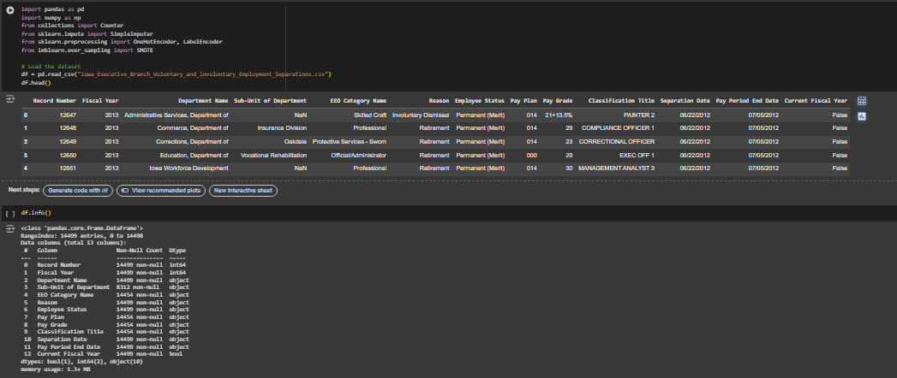

Slide 13
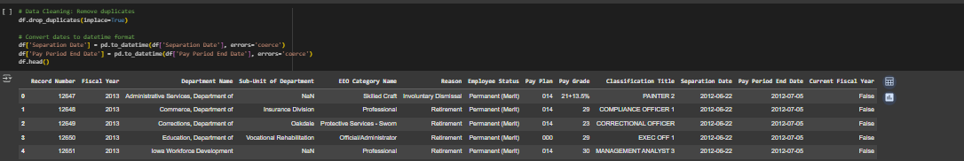
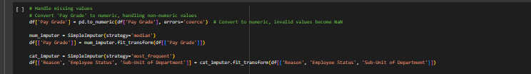
Data Cleaning
• Removal of duplicates: Eliminated duplicate records to prevent data distortion.
• Date Formatting: Converted Separation Date and Pay Period End Date to datetime type for easier chronological comparison.
• Missing Value Handling:
Numeric Columns: Numerical columns with missing values (for instance, Pay Grade) were imputed with the median in order to minimize skewness.

Slide 14
Feature Engineering
To derive additional insights, new features were created from existing attributes:
• Separation Year: Derived from the Separation Date in order to examine year-by-year trends in separations.
• Recent Layoff Flag: Included a Boolean flag for layoffs subsequent to the year 2018, reflecting the latest labor market trends.
• Separation Type Classification
Voluntary Separations: Transfers, retirements, and
Involuntary Separations: Layoffs, dismissals, and terminations.
They make the data more interpretable and easier for predictive modeling.

Slide 15
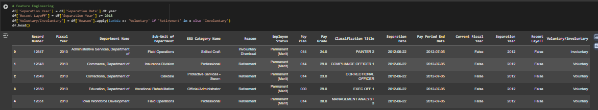
Feature Engineering

Slide 16
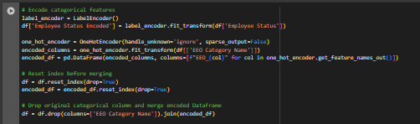
Encoding Categorical Data
Categorical variables were converted to numerical values for statistical analysis as well as training the machine learning model:
• Label Encoding: Used for Employee Status to provide numerical values for the type of employment.
• One-Hot Encoding: Used for categorical variables such as EEO Category Name and Reason, converting them into binary columns for the purpose of increased model compatibility.

Slide 17
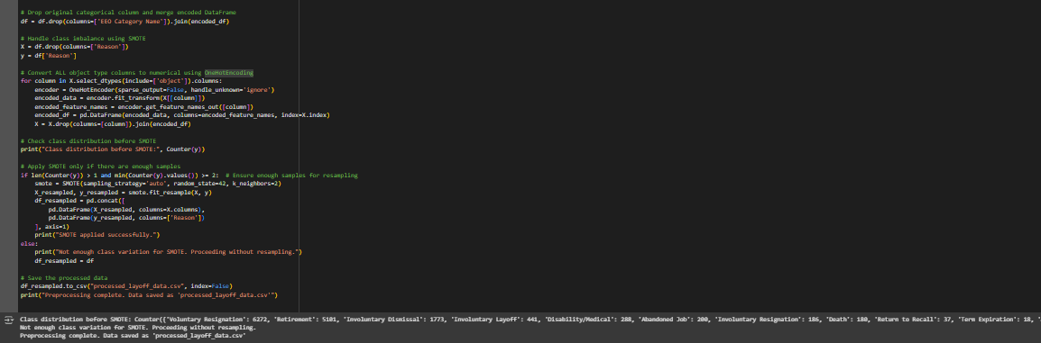
Addressing Class Imbalance with SMOTE
The data revealed a wide class imbalance, most significantly in the Reason column, with voluntary separations heavily outnumbering the involuntary separations. To offset this imbalance:
1. Applied One-Hot Encoding to transform categorical variables into numeric variables.
2. Utilized Applied Synthetic Minority Over-sampling Technique (SMOTE) for balancing classes.
3. Utilized k-Nearest Neighbors with k=2 for enhanced synthetic
4. Verified Class Distribution before and after resampling for data quality.
SMOTE guarantees the equal treatment of dismissals and layoffs, leading to a balanced data set for predictive modeling.

Slide 18
Summary of Findings
The processed dataset enables meaningful exploratory analysis.
Processed dataset stored as 'processed_layoff_data.csv’.
Data is now suitable for advanced analysis and machine learning applications.
SMOTE has improved class distribution for better predictive modeling.
Identified workforce trends that inform policy and planning.
Provides insights for workforce stability and restructuring.
Serves as a baseline for predictive modeling and advanced analysis.

Slide 19
Reference
Bali, R., Sharma, A., Mala, S., & Malhan, Y. (2024). Modeling the Geospatial Trend Changes in Jobs and Layoffs by Performing Sentiment Analysis on Twitter Data. International Journal of Performability Engineering, 20(2). https://openurl.ebsco.com/EPDB%3Agcd%3A8%3A18249768/detailv2?sid=ebsco%3Aplink%3Ascholar&id=ebsco%3Agcd%3A175379479&crl=c&link_origin=scholar.google.com
Eshghi, K., & Astvansh, V. (2024). Stock investors' reaction to layoff announcements: A meta‐analysis. Human Resource Management Journal, 34(3), 792-809. https://onlinelibrary.wiley.com/doi/full/10.1111/1748-8583.12532
Granulo, A., Kranzbühler, A. M., Fuchs, C., & Puntoni, S. (2025). Collective Layoffs and Offshoring: A Social Contract Account. Journal of Consumer Research, ucaf001. https://doi.org/10.1093/jcr/ucaf001
Hossen, M. N., Mollah, M. A., Lipy, N. S., Hossain, G. M. S., & Rahman, M. S. (2023). Factors affecting layoff in high-tech industry: Evidence from USA. International Journal of Information, Business and Management, 15(1), 1-13. https://www.proquest.com/openview/dff61e6a756dd2a2a006b8407833566d/1?pq-origsite=gscholar&cbl=2032142
Joshi, S. (2025). The Transformative Role of Agentic GenAI in Shaping Workforce Development and Education in the US. Iconic Research And Engineering Journals, 8(8), 199-206. https://www.jstor.org/stable/48716861

Slide 20
Reference
Krolikowski, P. M., & Lunsford, K. G. (2024). Advance layoff notices and aggregate job loss. Journal of Applied Econometrics, 39(3), 462-480. https://doi.org/10.1002/jae.3032
Liu, Z., & Liang, H. (2023). Permanent layoff and consumer credit card loss forecasting. Managerial Finance, Vol. 49 No. 5, pp. 789-807. https://doi.org/10.1108/MF-02-2022-0085
Penn, R., & Nezamis, E. (2022). Job openings and quits reach record highs in 2021, layoffs and discharges fall to record lows. Monthly Labor Review.
Prakash, P., & Sakthivel, V. (2024, February). Layoffs Analysis and Prediction Using Machine Learning Algorithms. In International Conference on Communications and Cyber Physical Engineering 2018 vol 1096 (pp. 535-543). Singapore: Springer Nature Singapore https://doi.org/10.1007/978-981-99-7137-4_53
Tomaskovic-Devey, D., Kerrissey, J., Rainey, A., & Boutcher, S. A. (2024). Intersectional Earnings Inequalities in US Public Sector Workplaces and the Great Recession. Socius, 10, 23780231241257778. https://doi.org/10.1177/23780231241257778

